Slide 1
VÄGEN TILL MOLNET ÖPPEN KÄLLKOD OCH CLOUD NATIVE MINSKAR RISKERNA
Björn Arkenfall
Publicity: Open

Slide 2
AGENDA
INTRODUKTION
14.00-14.10, Björn Arkenfall, Enfo
Cloud Native – en introduktion
14.10-14.50, Lars Andersson, Enfo
FIKA
Going all in on cloud
15.20-16.00, Niklas Gustavsson, Spotify
Ökad förändringshastighet med open source api management
16.00-16.40, Johan Edling, Lindex
Diskussion
16.40-17.00
Afterwork!

Slide 3
Lars andersson
open source and cloud native –
an introduction
Notes:
3

Slide 4
agenda
Open source intro
Cloud native intro
THE Cloud native computing foundation (CNCF)
Summary and key takeaways

Slide 5

Introduction to

Slide 6
Open source software (OSS)
Open Source Software (OSS) is software whose license permits source code to be published and made available to the public, allowing anyone to use, copy, modify, and redistribute without payment of royalties or fees.
Open Source are concerned solely with the licensing of the source code. This allows Open Source code to evolve organically, by way of community cooperation.
The “Open Source” label was created at a strategy meeting at the Open Source Initiative (OSI) February 3rd, 1998. The OSI acts as an advocate, an educator, and a steward of Open Source activities.

Slide 7
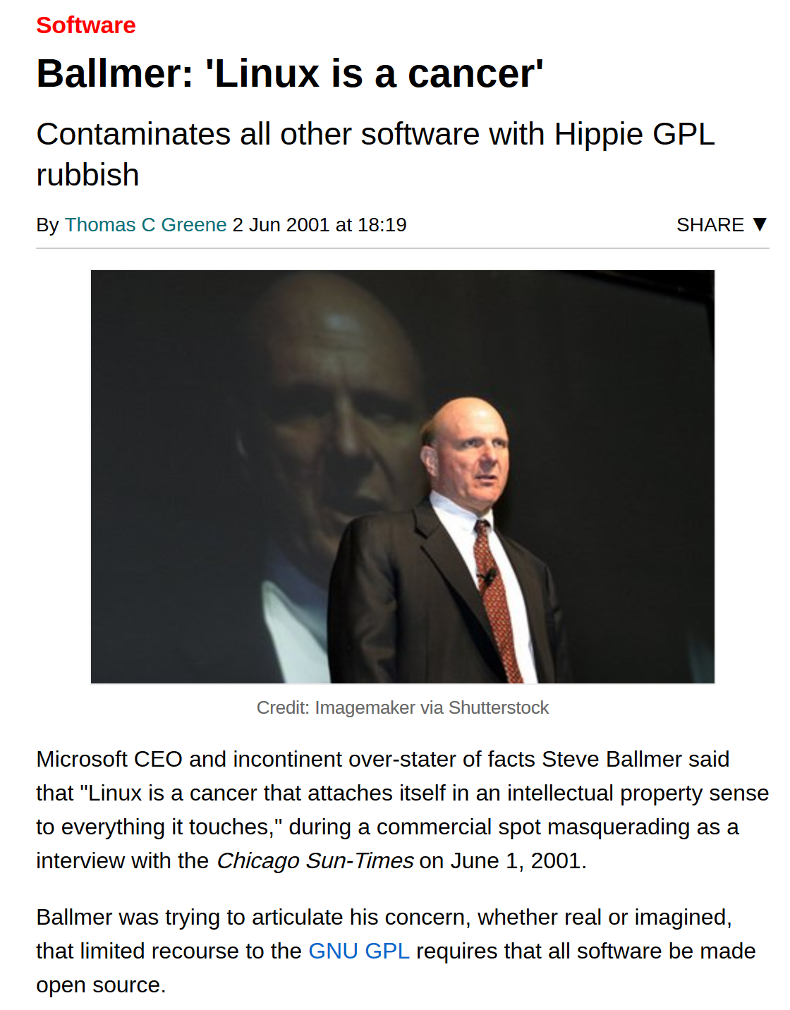

Microsoft’s war on OSS
“Open Source is an intellectual property destroyer. I can’t imagine something that could be worse than this for the software business and the intellectual-property business.”
Jim Allchin, former Microsoft executive, 2001
Notes:
Jag tycker att radavståndet i brödtexten är för litet

Slide 8
Advantages of using oss
Freedom of choice
Accelerated innovation
Reduced development costs and time to market
Attracting and retaining developer skills
Improved developer skills
Increased developer productivity
Increased security
Avoid vendor lock-in
Simplified procurement processes
Notes:
Jag tycker att radavståndet i brödtexten är för litet

Slide 9
The OSS year of 2018
The Open Source Initiative (OSI) celebrated its 20th Anniversary
Microsoft acquires GitHub for $7.5 billion
“Microsoft is a developer-first company, and by joining forces with GitHub we strengthen our commitment to developer freedom, openness and innovation.”
Microsoft joins the Open Invention Network (OIN), a patent community that protects Linux and other OSS programs, and plans to bring 60,000 patents to OIN
“We know Microsoft’s decision to join OIN may be viewed as surprising to some; it is no secret that there has been friction in the past between Microsoft and the open source community over the issue of patents. For others who have followed our evolution, we hope this announcement will be viewed as the next logical step for a company that is listening to customers and developers and is firmly committed to Linux and other open source programs.”
IBM acquires Red Hat for $34 billion
Notes:
Jag tycker att radavståndet i brödtexten är för litet

Slide 10
Startup company Tidelift oss survey
Insight 1
Open source is everywhere
92% of applications contains open source libraries
Insight 2
Professional users want maintenance, an active community, software that is secure and timely bug fixes —in that order
Respondents rated an active community as being over 20% more important than the popularity of a project
Insight 3
Only 9% of organizations have a formal process for how to evaluate open source
Respondents said it was a team decision (43%), developer decision (24%) or an informal process (22%)
Insight 4
83% of professional users will pay for supported open source
Of those, 63 % will pay up to $12000 a year, and 20% even more
Notes:
Jag tycker att radavståndet i brödtexten är för litet

Slide 11
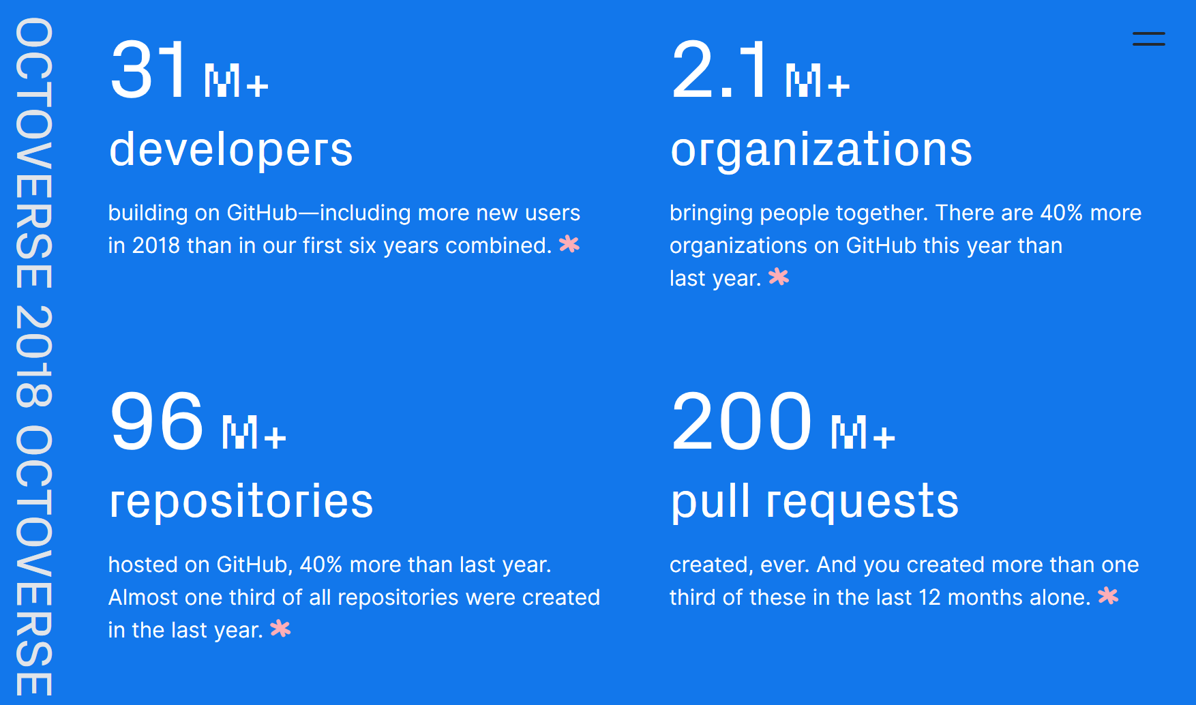
Github state of the octoverse 2018
Notes:
Jag tycker att radavståndet i brödtexten är för litet

Slide 12
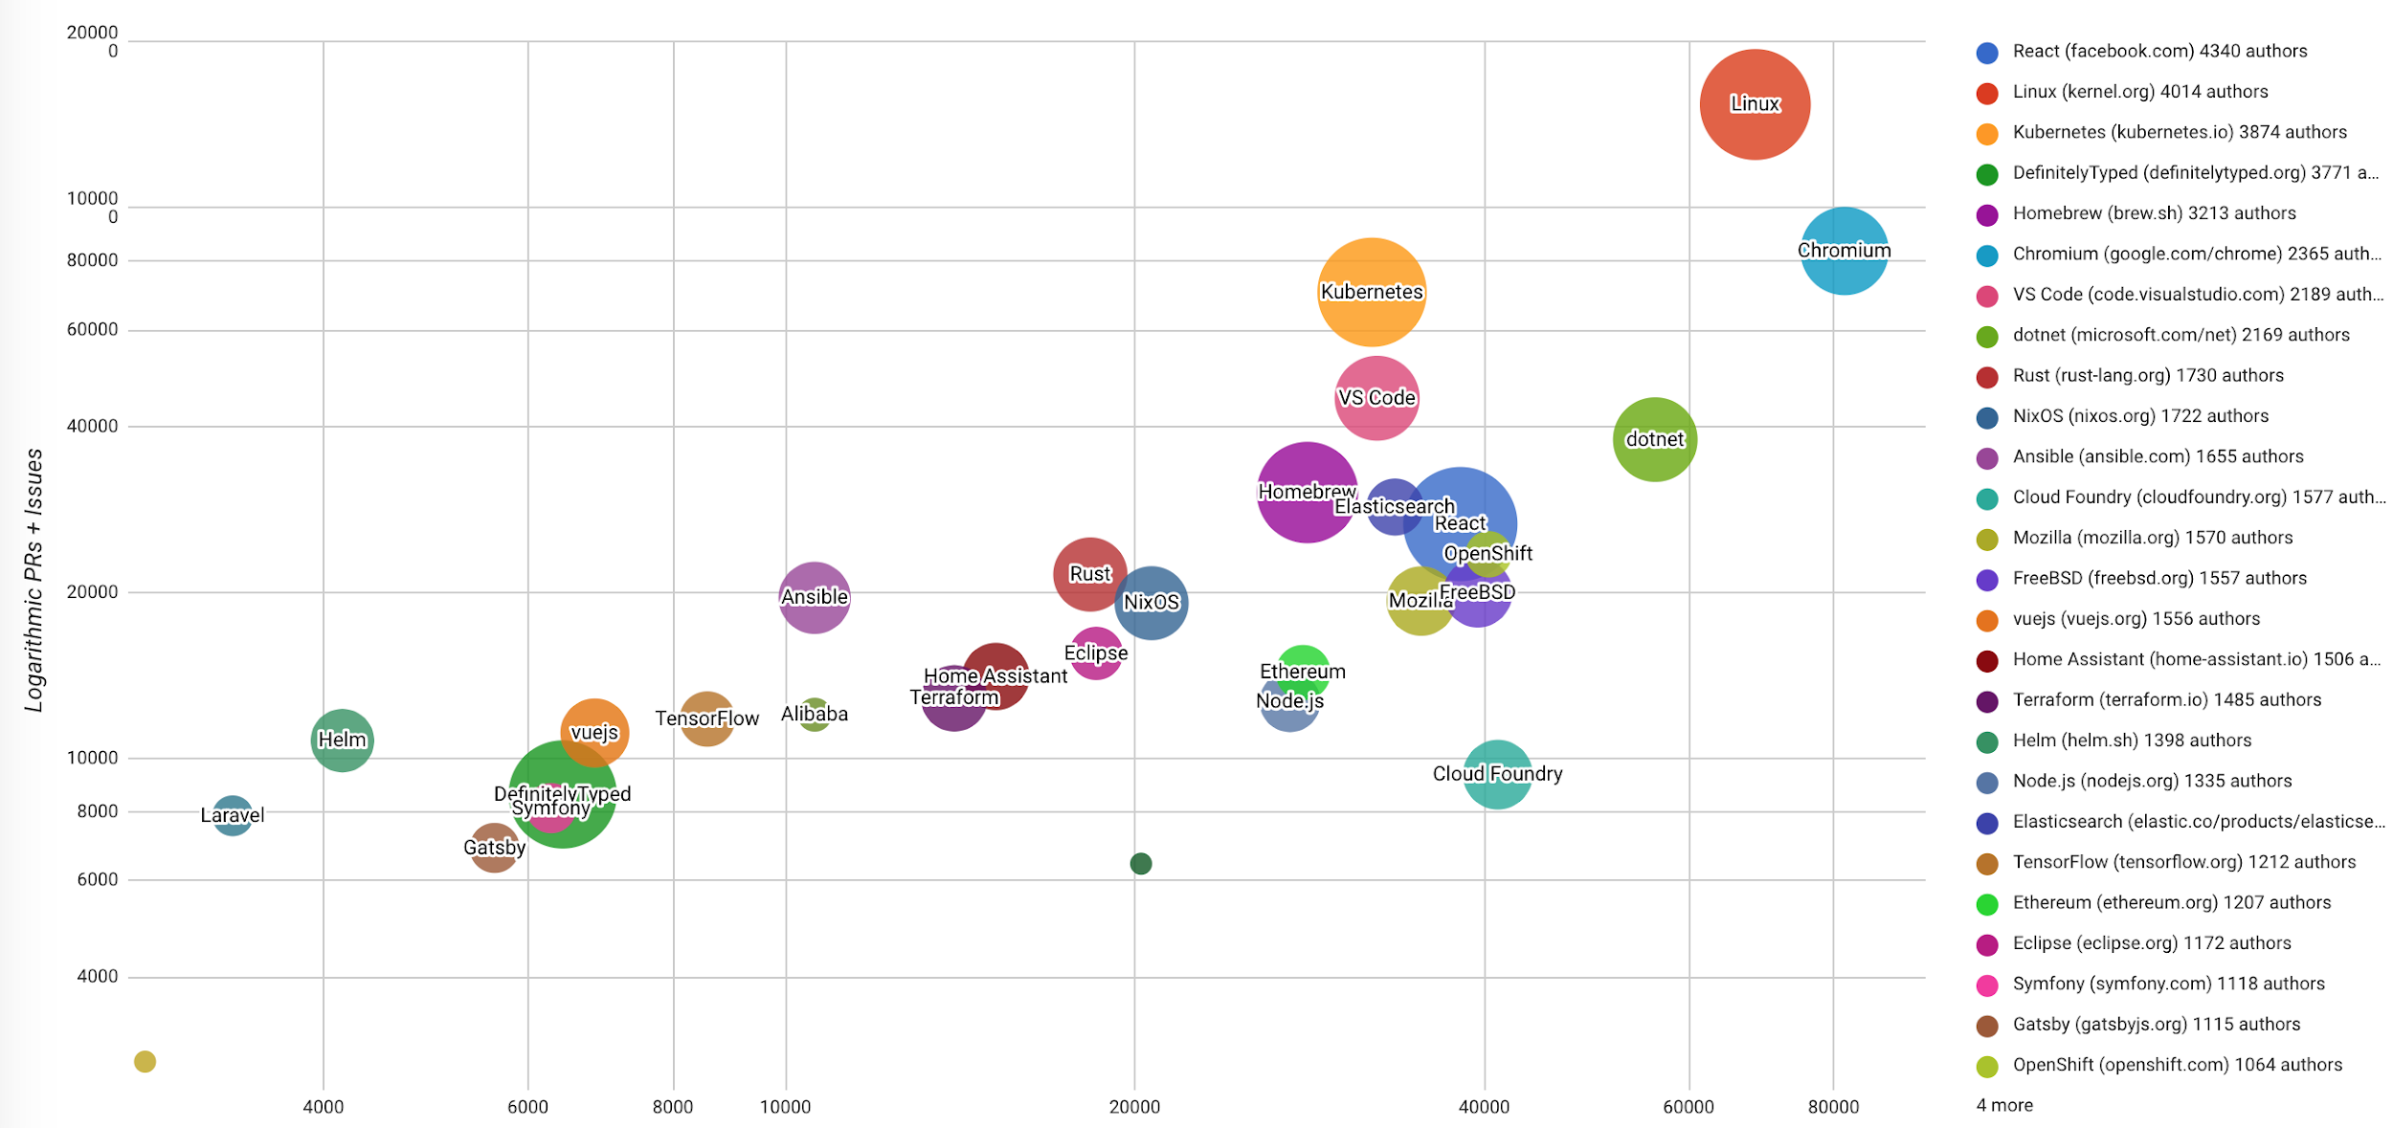
Highest velocity Top-30 oss projects
2017-11 to 2018-10
Number of Commits
Notes:
Jag tycker att radavståndet i brödtexten är för litet

Slide 13
Cloud native
Introduction to
“The cloud isn’t a place, it’s a way of doing IT”
Michael Dell, founder and CEO, Dell Technologies

Slide 14




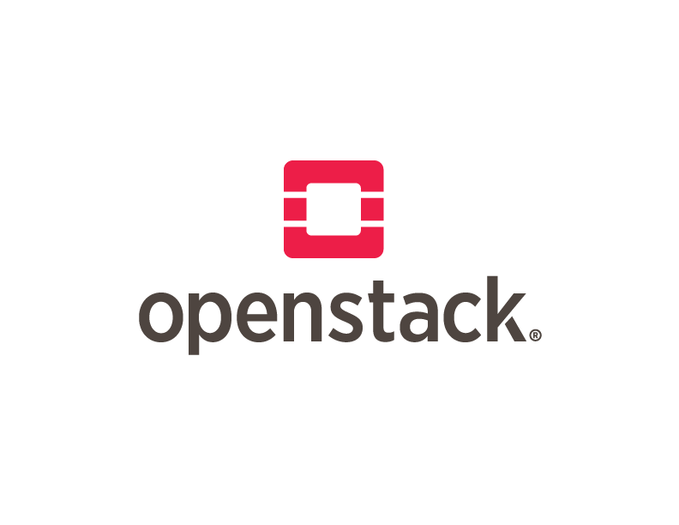



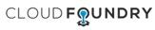

From virtualization to cloud native
Non- Virtualized
Hardware
Open Source
IaaS
Open Source
PaaS
Cloud Native
Virtualiza- tion
IaaS
PaaS
Containers
2000
2001
2006
2009
2010
2011
2013
2015
Notes:
Jag tycker att radavståndet i brödtexten är för litet

Slide 15
Cloud native definition
“Cloud native is structuring teams, culture and technology to utilize automation and architectures to manage complexity and unlock velocity.”
Joe Beda, CTO of Heptia , Started Google Compute Engine
“Cloud native technologies empower organizations to build and run scalable applications in modern, dynamic environments such as public, private, and hybrid clouds.”
“These techniques enable loosely coupled systems that are resilient, manageable, and observable. Combined with robust automation, they allow engineers to make high-impact changes frequently and predictably with minimal toil.”
CNCF Cloud Native Definition v1.0
Notes:
Jag tycker att radavståndet i brödtexten är för litet

Slide 16
Cloud native core attributes
According to the CNCF, cloud native systems will have the following properties:
Microservices. An architectural style that structures an application as a collection of loosely coupled services, which implement business capabilities.
Containers. A container is a standard unit of software that packages up code and all its dependencies so the application runs quickly and reliably from one computing environment to another.
Orchestration of containers. Containers are actively scheduled and managed by a central orchestrating process. This radically improves machine efficiency and resource utilization while reducing the cost associated with maintenance and operations.
Notes:
Jag tycker att radavståndet i brödtexten är för litet

Slide 17
Characteristics of a Microservices architecture
According to Martin Fowler:
Decentralized data management
Infrastructure automation
Design for failure
Evolutionary design
Componentization via services
Organized around business capabilities
Products not projects
Smart endpoints and dumb pipes
Decentralized governance
Notes:
Jag tycker att radavståndet i brödtexten är för litet

Slide 18
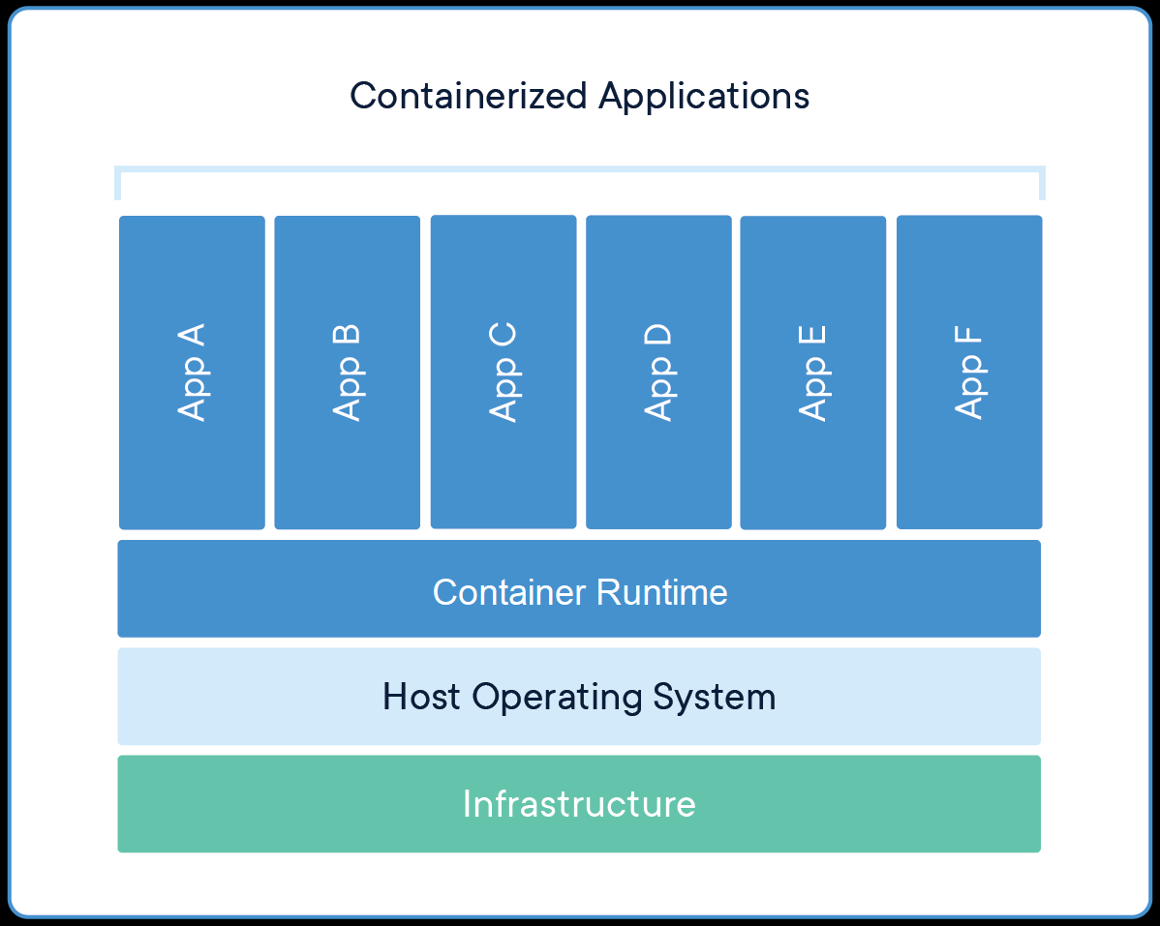
containers
Containers are an abstraction at the app layer that packages code and dependencies together.
Multiple containers can run on the same machine and share the OS kernel with other containers, each running as isolated processes
in user space.
Advantages of using containers over VM’s:
Developer experience
Portability
Lightweight
Notes:
Jag tycker att radavståndet i brödtexten är för litet

Slide 19
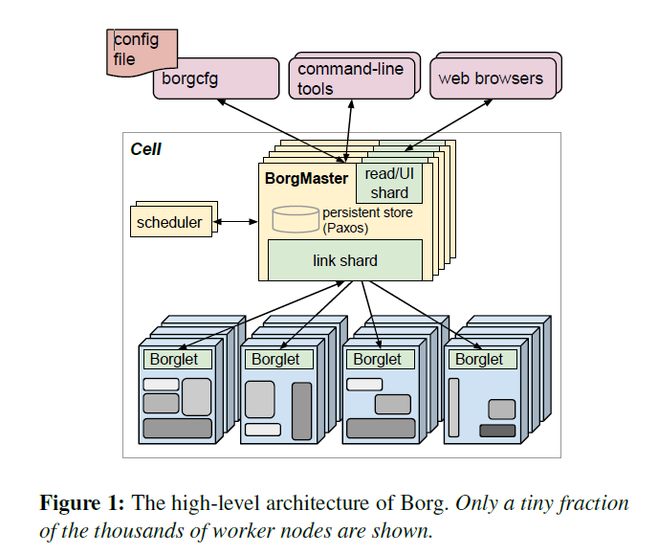
Container orchestration
Google Borg (~2005): The Predecessor to Kubernetes
Cluster manager, running hundreds of thousands of jobs, from many thousands of different applications, across a number of clusters, each with up to tens of thousands of machines.
Four Kubernetes features that came from Google’s experiences with Borg:
Pods
Services
Labels
IP per Pod
Notes:
Jag tycker att radavståndet i brödtexten är för litet

Slide 20

kubernetes
Google open-sourced the Kubernetes project in mid 2014
A year later, July 21st 2015, Kubernetes v 1.0 was released, and Google partnered with the Linux Foundation to form the CNCF
Kubernetes is a portable, extensible open-source platform for managing containerized workloads and services, that facilitates both declarative configuration and automation. It has a large, rapidly growing ecosystem. Kubernetes services, support, and tools are widely available
Can be deployed anywhere
Kubernetes was the first CNCF project to graduate, in March 2018
Notes:
Jag tycker att radavståndet i brödtexten är för litet

Slide 21
Cloud native business value
According to the CNCF Survey – August 2018 – the top three (% of respondents) advantages of adopting cloud native are
Faster deployment time (50%). Being able to develop and deploy applications faster results in increased agility and revenues and reduced operating costs.
Improved scalability (45%). Cloud native scales from several nodes on a laptop to tens of thousands of self-healing multi-tenant nodes.
Cloud portability (42%). The cloud native, open source software stack hosted by the CNCF, enables deployment on-premise, on any public, private or hybrid cloud.
Notes:
Jag tycker att radavståndet i brödtexten är för litet

Slide 22
Cloud native business value (cont.)
Outside of the top three advantages, there are:
Increased maintainability. This advantage is accomplished by splitting applications into micro services with explicitly described dependencies.
Improved resilience. A cloud native platform can handle failures of individual containers, machines, and even data centers.
Improved efficiency and resource utilization. In the cloud native platform, a central process is responsible for dynamically manage and schedule micro services, packaged in containers, to run as needed.
Notes:
Jag tycker att radavståndet i brödtexten är för litet

Slide 23
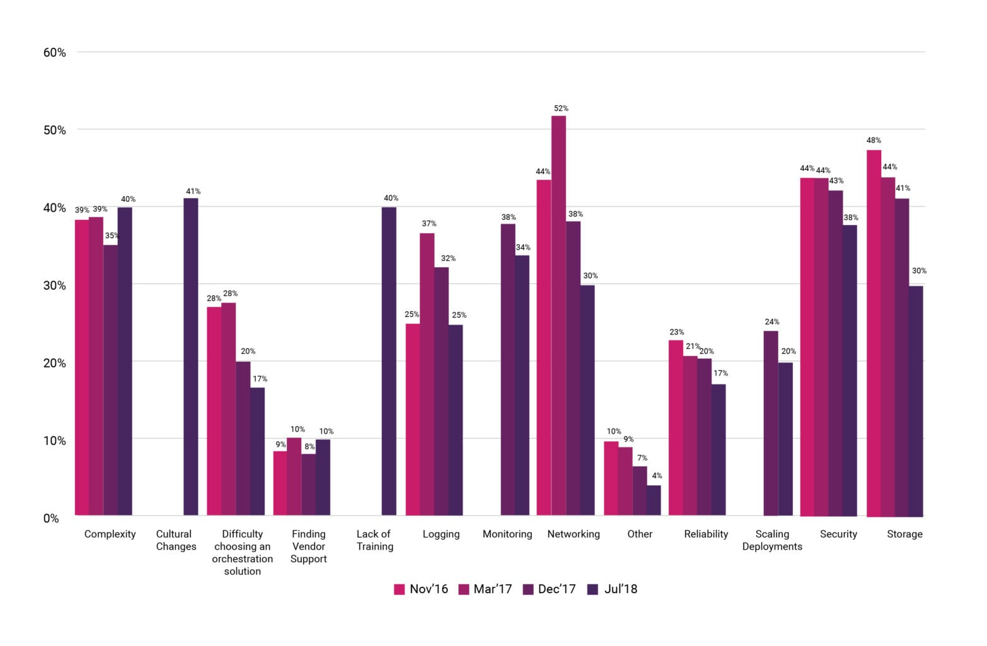
Challenges using containers
CNCF Survey – August 2018
3
2
1
2
Notes:
Jag tycker att radavståndet i brödtexten är för litet

Slide 24
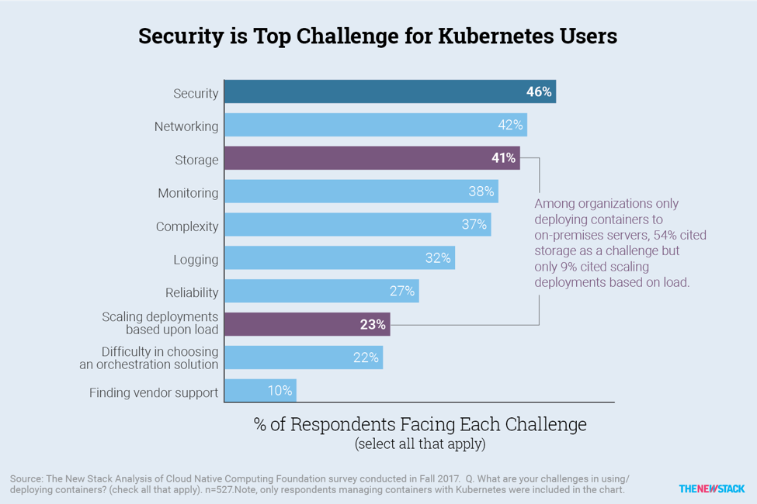
Challenges using kubernetes
Notes:
Jag tycker att radavståndet i brödtexten är för litet

Slide 25
State of cloud native
CNCF Survey – August 2018
Production usage of CNCF projects has grown more than 200% on average since December 2017, and evaluation has jumped 372%.
The use of serverless technology continues to grow, up 22% since December 2017, which means 38% of companies are using it, with the majority (32%) of respondents using hosted platforms such as AWS Lambda (70%), and the rest (6%) are using installable software.
40% of respondents from enterprise companies (5000+) are running Kubernetes in production.
58% of respondents (regardless of company size) are using Kubernetes in production, while 42% are evaluating it for future use
Notes:
Jag tycker att radavståndet i brödtexten är för litet

Slide 26
State of cloud native (cont.)
CNCF Survey – August 2018
73% of respondents are currently using containers in production. As for container management tools, Kubernetes remains the leader with 83% (up from 77%) of respondents using it, followed by Amazon ECS (24% up from 18%), Docker Swarm (21% up from 17%), and Shell Scripts (20% up from 12%).
64% of companies still use on-premise data centers. Public cloud is used by 77% and private cloud by 50% of the companies. This, and other studies indicate that companies have a hybrid environment with multiple clouds.
Notes:
Jag tycker att radavståndet i brödtexten är för litet

Slide 27
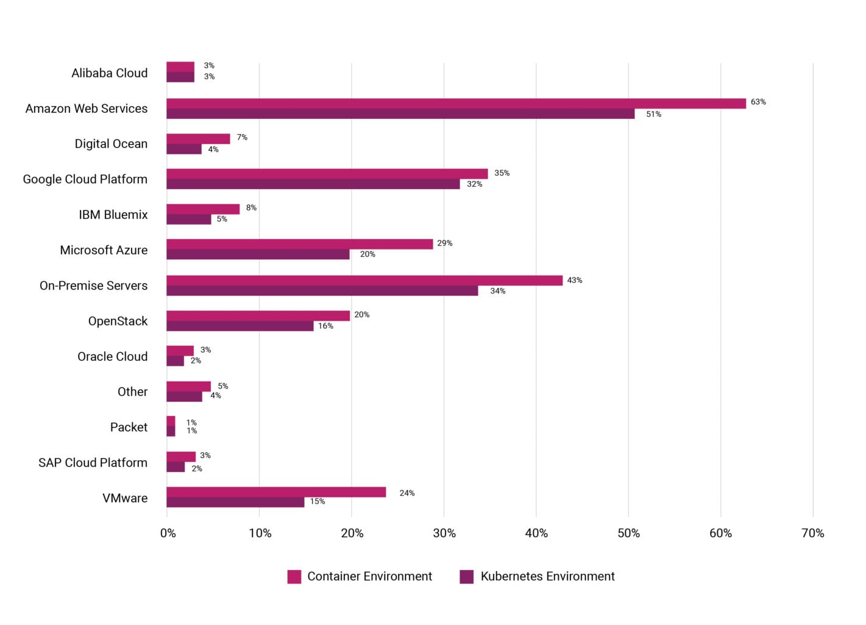
State of cloud native (cont.)
1
3
2
CNCF Survey – August 2018
Which environment is Kubernetes
being run in?
Rising star? (up to 15% from 1%)
Notes:
Jag tycker att radavståndet i brödtexten är för litet

Slide 28


Slide 29
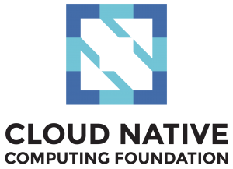
CNCF – mission & role
“The Foundation’s mission is to create and drive the adoption of a new computing paradigm that is optimized for modern distributed systems environments capable of scaling to tens of thousands of self healing multi-tenant nodes.”
The foundation will serve a role in the open source community responsible for:
Stewardship of the projects
https://www.cncf.io/
Fostering the growth and evolution of the ecosystem
Promotion of the underlying technologies
Serve the community by making the technology accessible and reliable
Notes:
Jag tycker att radavståndet i brödtexten är för litet

Slide 30
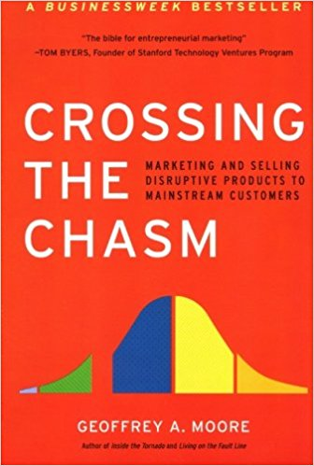


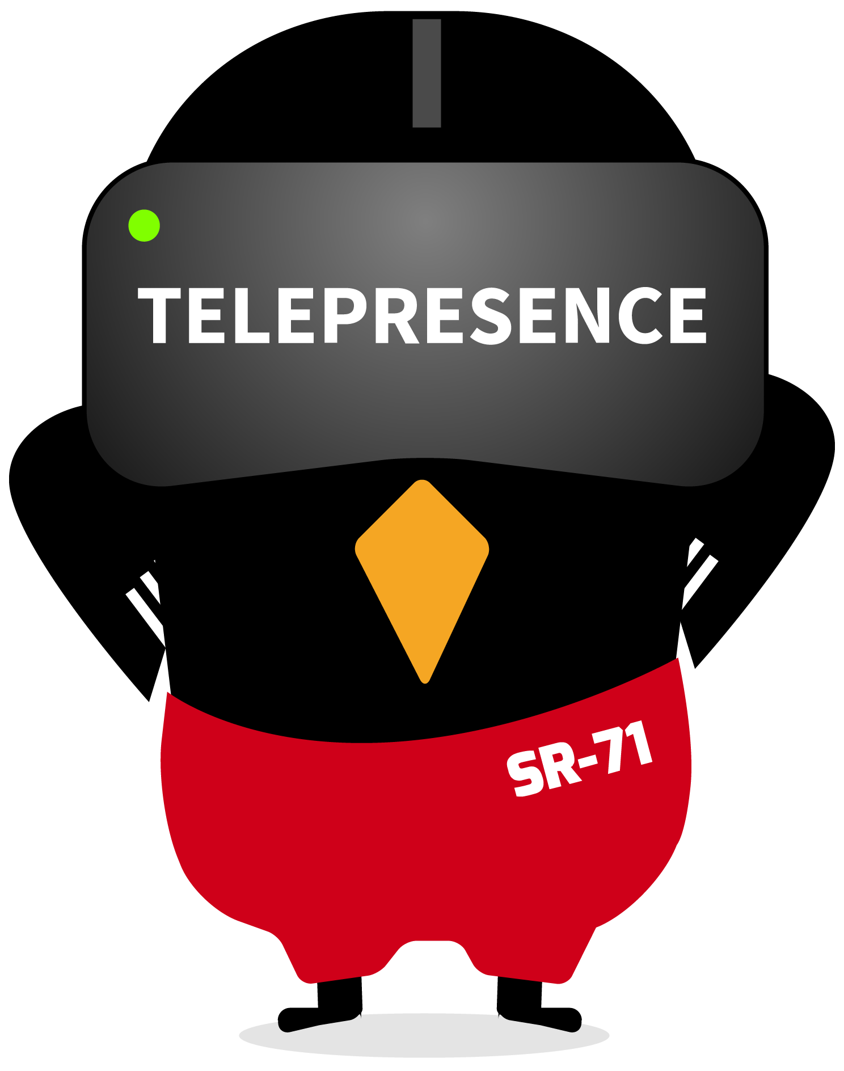




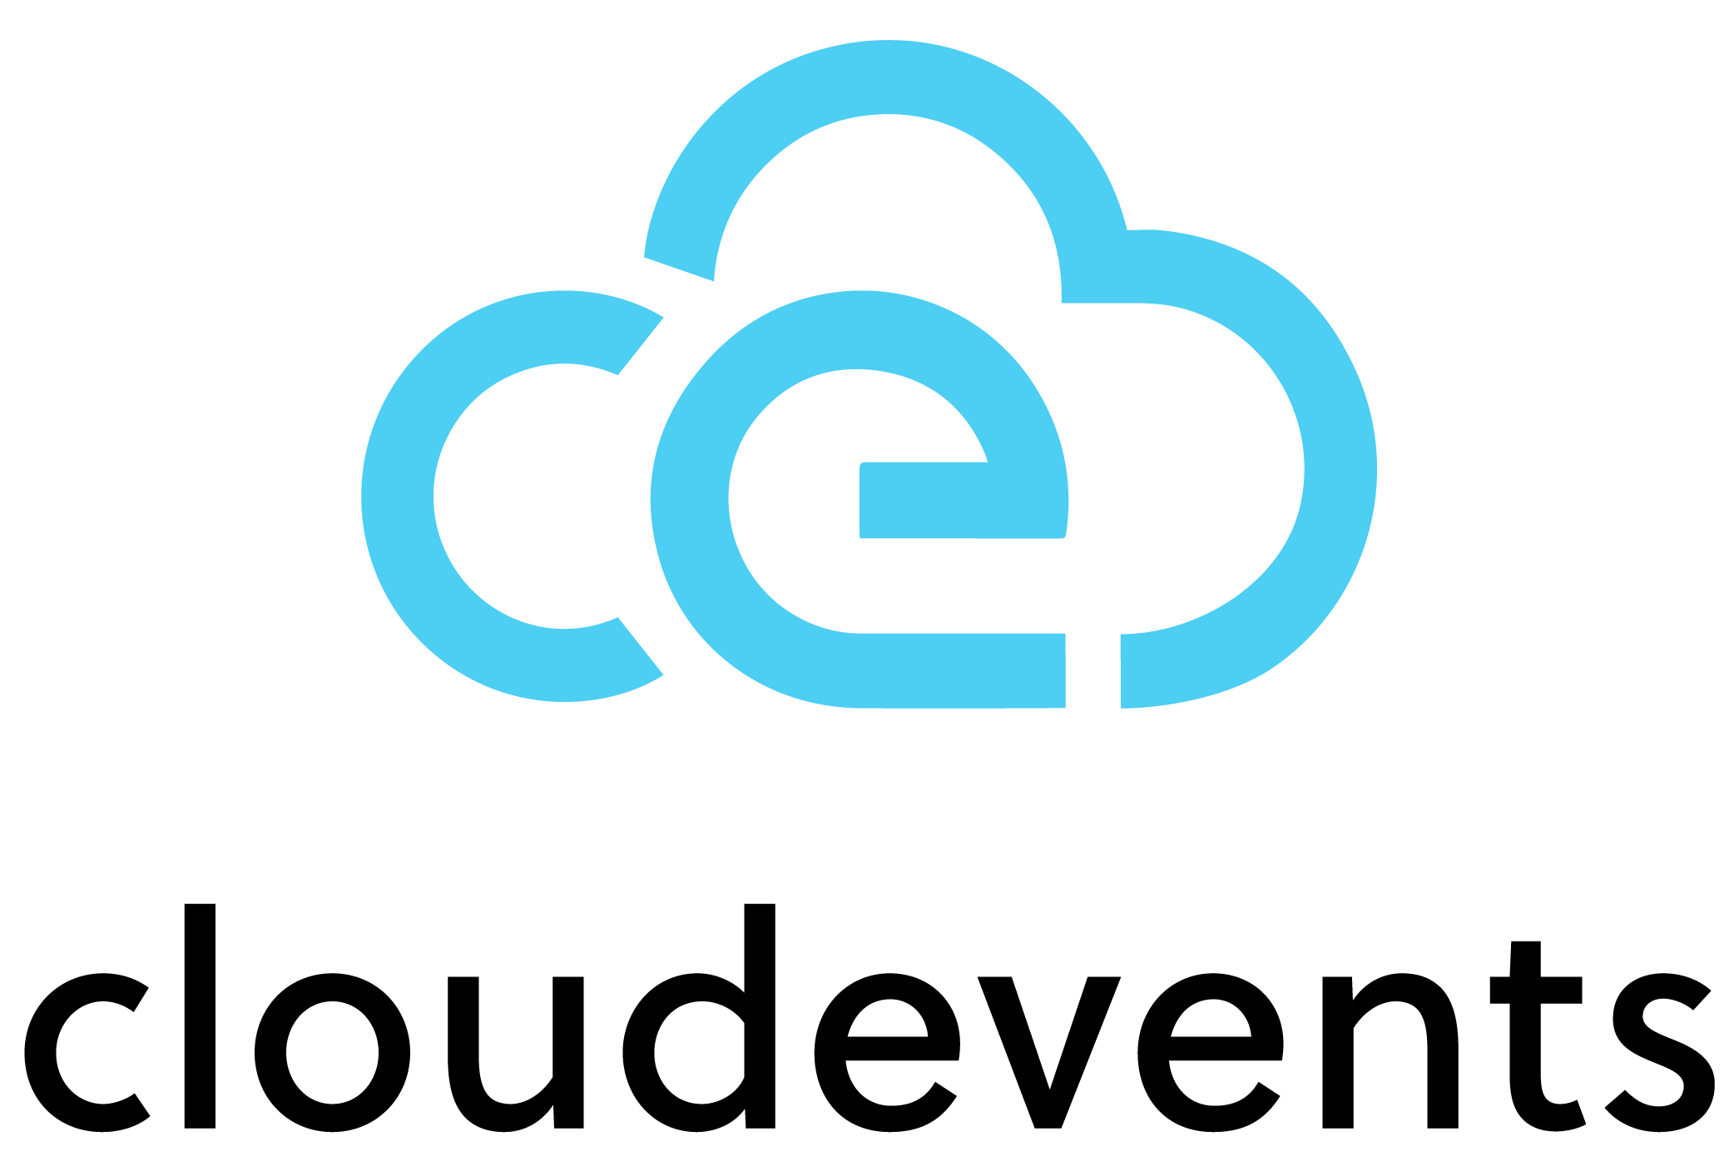
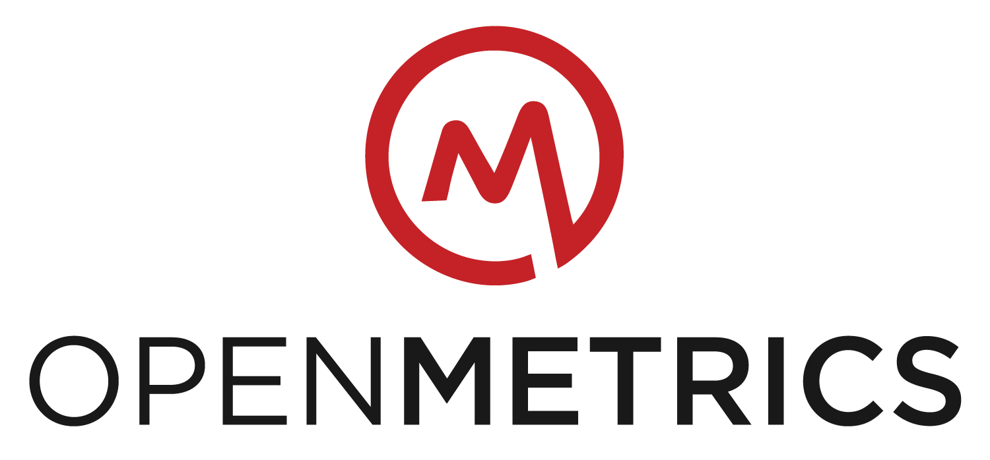
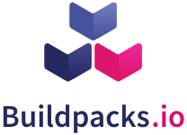
Cncf project maturities
GRADUATED
LATE MAJORITY
“CONSERVATIVES”
“THE CHASM”
INCUBATING
INNOVATORS
“TECHIES”
SANDBOX
EARLY ADOPTERS
“VISIONARIES”
EARLY MAJORITY
“PRAGMATISTS”
LAGGARDS
“SKEPTICS”
SANDBOX
Identity
Policy
Serverless
Tooling
Registry
Metrics Spec
Distributed K/V
Monitoring
Packaging Spec
Container Security
Notes:
Jag tycker att radavståndet i brödtexten är för litet

Slide 31
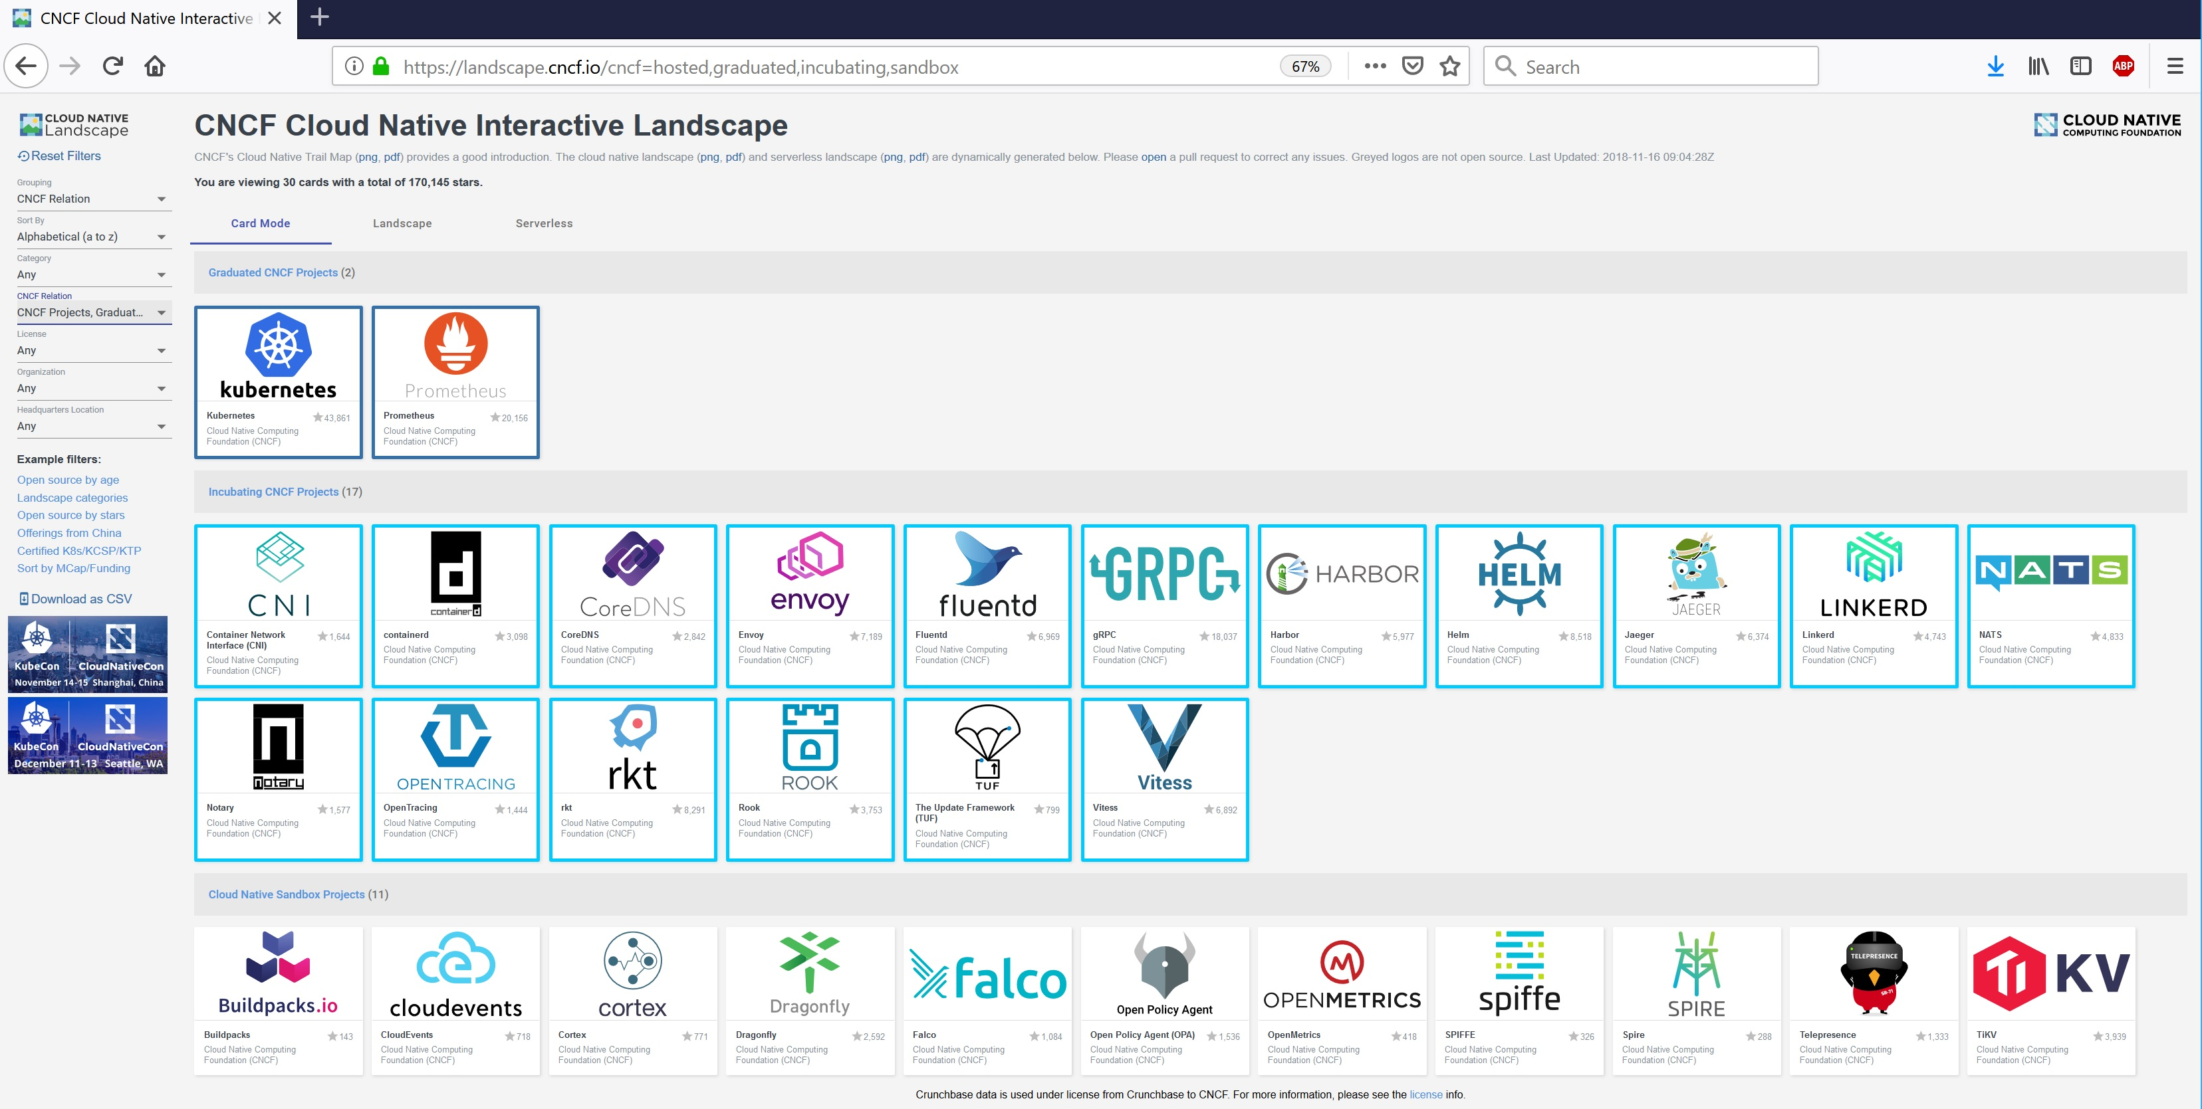
CNCF HOSTED PROJECTS
https://landscape.cncf.io/
Notes:
Jag tycker att radavståndet i brödtexten är för litet

Slide 32
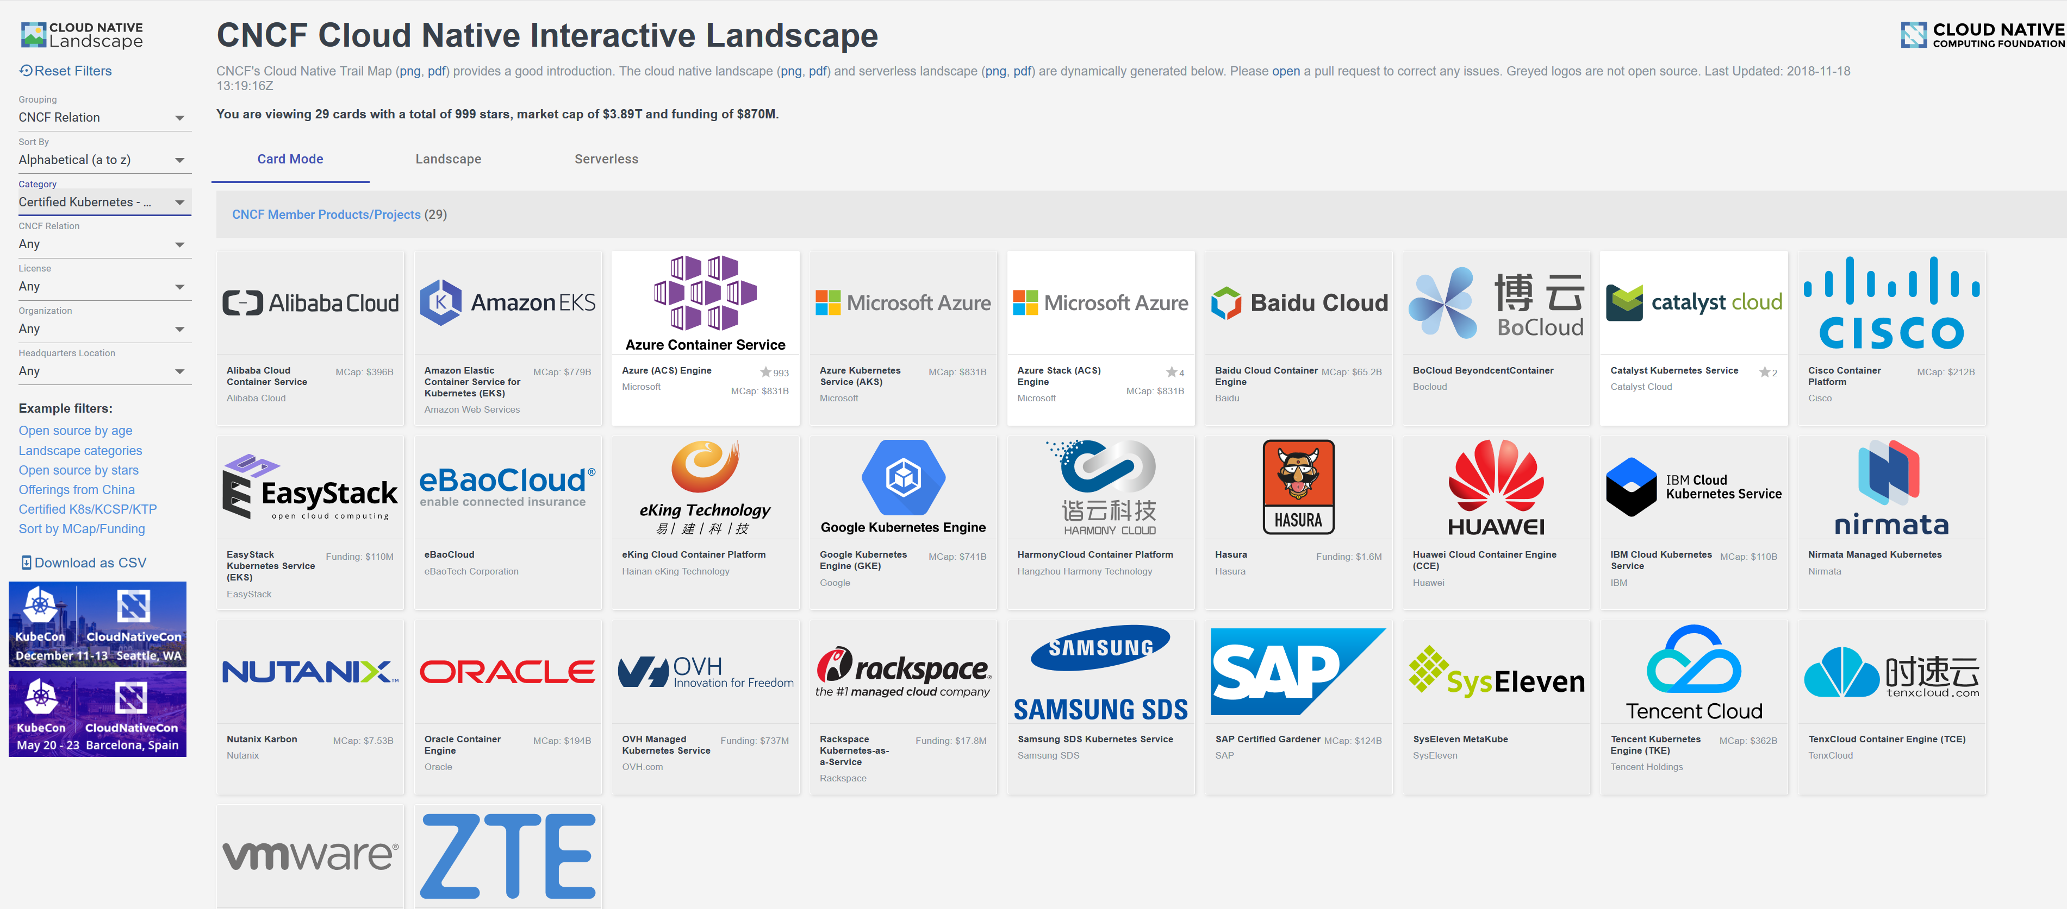
Certified Kubernetes - hosted
Notes:
Jag tycker att radavståndet i brödtexten är för litet

Slide 33
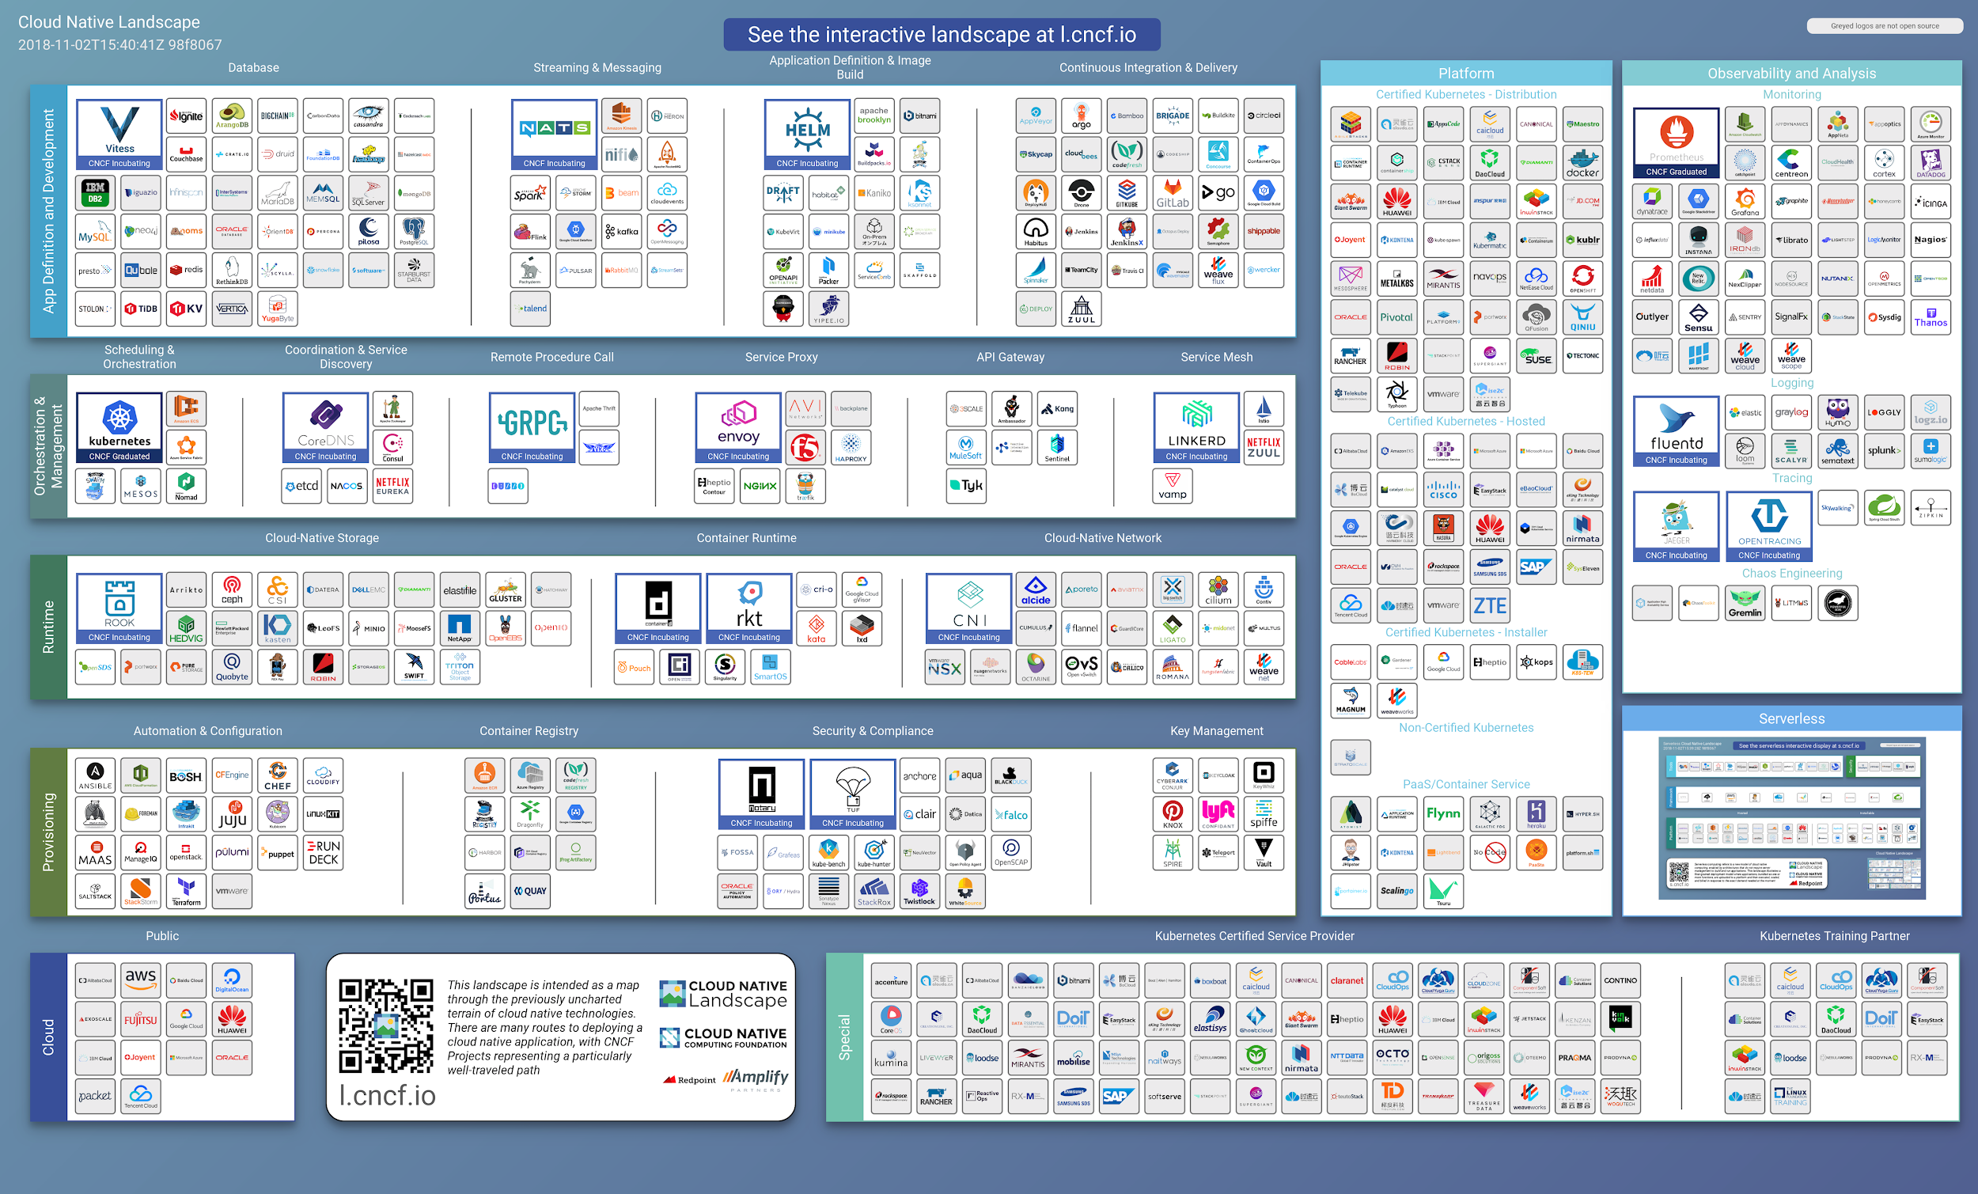

Slide 34

Key takeaways
summary
KEY
TAKEAWAYS

Slide 35
Key takeaways
The cloud isn't a place, it's a way of doing IT
Enterprises are going multicloud
Cloud Native technology can be deployed anywhere
Cloud Native is not all about technology
Cloud native promises increased agility, increased scalability and eliminating the risk of vendor lock-in
Serverless is coming
Notes:
Jag tycker att radavståndet i brödtexten är för litet

Slide 36

Key takeaways
Open Source Software is the key:
“With the ever-growing diversity of integrating endpoints, open source software and vendors are the only viable way to ensure technology keeps pace with market needs.”
“The protocols, data formats and APIs of endpoints change so frequently that only a community, collaboration, and shared approach available through open source can address the future needs of integrators.”
Tyler Jewell, CEO of WSO2
Notes:
Jag tycker att radavståndet i brödtexten är för litet

Slide 37
Thank you!
For more information please contact me personally or visit us in one of our social media channels.
Lars Andersson
Tech Lead, Open Source +46 732 330387 lars.andersson@enfogroup.com

